Slide 1
Uncertainty Quantification for Next-Generation Architectures
Eric Phipps (etphipp@sandia.gov),
H. Carter Edwards, Jonathan Hu
Sandia National Laboratories
Programming Models and Applications Workshop
August 5-6, 2014
SAND2014-16397PE
Sandia National Laboratories is a multi-program laboratory managed and operated by Sandia Corporation, a wholly owned subsidiary of Lockheed Martin Corporation, for the U.S. Department of Energy's National Nuclear Security Administration under contract DE-AC04-94AL85000.
Notes:
The ideas I am going to present today are ideas that several of us at Sandia and Oak Ridge have been thinking about for a while now on how to most effectively implement uncertainty calculations on likely exascale architectures.

Slide 2
Can Exascale Solve the UQ Challenge?
UQ means many things
  Best estimate + uncertainty, model validation, model calibration, …
A key to many UQ tasks is forward uncertainty propagation
  Given uncertainty model of input data (aleatory, epistemic, …)
  Propagate uncertainty to output quantities of interest
There are many forward uncertainty propagation approaches
  Monte Carlo, stochastic collocation, polynomial chaos, stochastic Galerkin, …
Key challenge:
  Accurately quantifying rare events and localized behavior in high-dimensional uncertain input spaces
  Can easily require O(10⁴-10⁶) expensive forward simulations
  Often can only afford O(10²) on today’s petascale machines

Slide 3
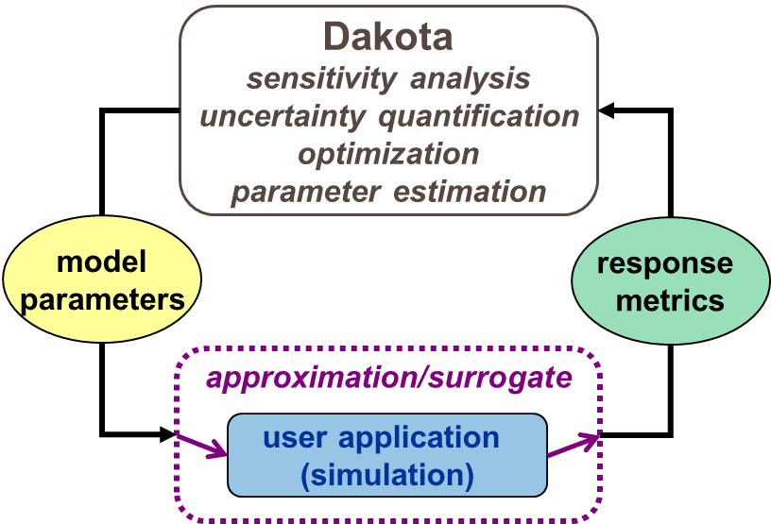

Emerging Architectures Motivate New
Approaches to Predictive Simulation
UQ approaches traditionally implemented as an outer loop:
  Aggregate UQ performance limited to that of underlying deterministic simulation
  Will require very good strong scalability to very high thread-counts
Achieving this is difficult for many types of PDE simulations
  Irregular memory access patterns
  Inconsistent vectorization
http://dakota.sandia.gov

Slide 4
Expose new dimensions of fine-grained parallelism through embedded approaches
Uncertainty propagation is often a better structured calculation than the original simulation
  Lots of reuse of data from simulation to simulation
  Many UQ methods rely on (local) smoothness, so data generated by solution process is often similar across samples
Take a holistic view of the entire UQ workflow
  Single-point forward simulation is no longer the end-point
  Codes are being rewritten for new architectures, why not treat uncertainty propagation as the basic unit of calculation?
Improve memory access patterns by inverting the outer UQ/inner solver loop
  Stochastic Galerkin (3rd of 3-year LDRD)
  Embedded ensemble propagation (1st of 3-year ASCR)

Slide 5
Polynomial Chaos Expansions (PCE)
Steady-state finite dimensional model problem:
(Global) Polynomial Chaos approximation:
  Multivariate orthogonal polynomials
  Typically constructed as tensor products with total order at most N
  Can be adapted (anisotropic, local support)
Non-intrusive polynomial chaos (NIPC, NISP):
  Sparse-grid quadrature methods for scalability to moderate stochastic dimensions

Slide 6
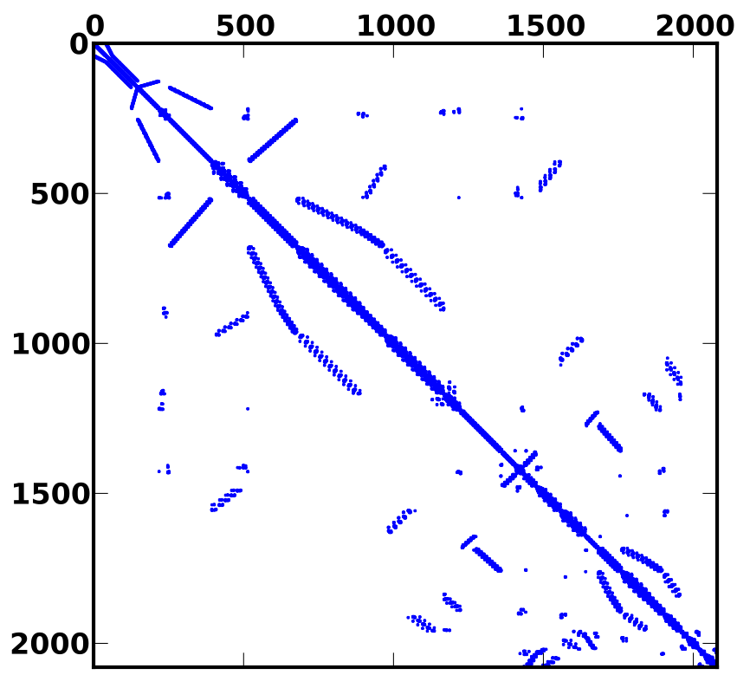

Simultaneous ensemble propagation
PDE:
Propagating m samples – block diagonal (nonlinear) system:

Slide 7
Simultaneous ensemble propagation
Commute Kronecker products (just a reordering of DoFs):
Each sample-dependent scalar replaced by length-m array
  Automatically reuse non-sample dependent data
  Sparse accesses amortized across ensemble
  Math on ensemble naturally maps to vector arithmetic

Slide 8
Potential Speed-up for PDE Assembly
Halo exchange
  Amortize MPI latency across ensemble
Gather
  Reuse node-index map (mesh)
  Replace sparse with contiguous loads
Local residual/Jacobian
  Vectorized math
Scatter
  Reuse node-index map and element graph (mesh)
  Replace sparse with contiguous stores

Slide 9
Potential Speed-up for Sparse Solvers
Ingredients to sparse linear system solvers (CG, GMRES, …)
  Sparse matrix-vector products
  Dot-products
  Preconditioners
    Relaxation-based (Jacobi, Gauss-Seidel, …)
    Incomplete factorizations (ILU, IC, …)
    Polynomial (Chebyshev, …)
    Multilevel (Algebraic/Geometric multigrid)
Sparse matrix-vector products
  Amortize MPI latency in halo exchange
  Reuse matrix graph
  Replace sparse with contiguous loads
  Vector arithmetic
Dot-products
  Amortize MPI latency
Preconditioners
  Sparse mat-vecs
  Sparse factorizations/triangular-solves
  Smaller, more unstructured matrices

Slide 10

Stokhos: Trilinos Tools for Embedded UQ Methods
Provides “ensemble scalar type”
  C++ class containing an array with length fixed at compile-time
  Overloads all math operations by mapping operation across array
  Uses expression templates to fuse loops
Enabled in simulation codes through template-based generic progamming
  Template C++ code on scalar type
  Instantiate template code on ensemble scalar type
Integrated with Kokkos (Edwards, Sunderland, Trott) for many-core parallelism
  Specializes Kokkos data-structures, execution policies to map vectorization parallelism across ensemble
  For CUDA, currently requires manual modification of parallel launch to use customized execution policies
Integrated with Tpetra-based solvers for hybrid (MPI+X) parallel linear algebra
  Exploits templating on scalar type
  Optimized linear algebra kernels for ensemble scalar type
  Krylov solvers (Belos), Incomplete factorization preconditioners (Ifpack2), algebraic multigrid preconditioners (MueLu)
http://trilinos.sandia.gov

Slide 11
Ensemble Scalar Type
namespace Sacado {
namespace UQ {
// The ensemble scalar type. Ensemble values contained in statically allocated
// array with fixed size Num
template <typename Value, int Num> class Ensemble {
// ...
Value values[Num];
};
}
}
// Overloaded math with expression templates
typedef Sacado::UQ::Ensemble<double,16> Scalar;
Scalar a; a[0] = 0.0; a[1] = 1.0; ...
double b = 2.0;
Scalar c = 3.0;
Scalar d = sin(a)*b + c;
// Generates code equivalent to (compiler can easily unroll, auto-vectorize loop)
for (int i=0; i<16; ++i)
d[i] = sin(a[i])*b + c[i];

Slide 12

Kokkos Integration
Views of ensemble scalar type internally stored as views of 1-higher rank
  Ensemble dimension is always contiguous, regardless of layout
  Requires specialized kernel launch for CUDA to map warp to ensemble dimension to achieve performance
Kokkos::View< Ensemble<double,4>*, LayoutRight, Device > view(“v”, 10);
Kokkos::View< Ensemble<double,4>*, LayoutLeft, Device > view(“v”, 10);

Slide 13
Template-Based Generic Programming Orthogonalizes Physics and Embedded Algorithm R&D
Notes:
Since then we have generalized this technique and codified its use in this components approach
In general C++ templates are a very powerful method of abstraction by introducing compile-time polymorphism
By templating algorithms on the scalar type, that is the floating point type, we can abstract different forms of embedded analysis
This is a generalization of the automatic differentiation techniques we have discussed in the past, and we call that generalization template-based generic programming
By templating the components on the scalar type, we provide an api…
Using this templated API, code developers can build whole physics codes that support embedded algorithms
There are other ways of supporting embedded algorithms, and various other packages such as those listed here have some support for them using different techniques, but the big advantage this approach has of the these others is ours is scalable to many types of embedded analysis.

Slide 14
Techniques Prototyped in FENL Mini-App
Simple nonlinear diffusion equation
  3-D, linear FEM discretization
  1x1x1 cube, unstructured mesh
  KL-like random field model for diffusion coefficient
  Trilinos-couplings Trilinos package
Hybrid MPI+X parallelism
  Traditional MPI domain decomposition using threads within each domain
Employs Kokkos for thread-scalable
  Graph construction
  PDE assembly
Employs Tpetra for distributed linear algebra
  CG iterative solver (Belos package)
  Smoothed Aggregation AMG preconditioning (MueLu)
Supports embedded ensemble propagation via Stokhos through entire assembly and solve
  Samples generated via tensor product & Smolyak sparse grid quadrature
http://trilinos.sandia.gov

Slide 15
Ensemble Assembly Speed-Up
Notes:
Single node performance, thread parallel_for over cells
Speed-up here is coming from contiguous loads/stores, mesh reuse for larger problem sizes. For smaller problem sizes, more work per thread

Slide 16
Ensemble MPI Halo-Exchange Speed-Up
Notes:
Speed-up here is coming from MPI latency amortized over ensemble

Slide 17
Ensemble Matrix-Vector Product Speed-Up
Notes:
Single node performance, thread-parallel_for over matrix rows
Speed-up here is coming from contiguous loads, reuse of matrix graph for larger problem sizes. For smaller sizes, more work per thread

Slide 18
Ensemble CG Speed-Up

Slide 19
Ensemble AMG-Preconditioned CG Speed-Up
Several ensemble AMG setup, solve kernels have not yet been optimized for GPU!
Notes:
Smoothed-aggregation algebraic multigrid via MueLu package, chebyshev smoothers, superlu coarse-grid solve (not thread parallel)
Speed-up comes from speed-up of mat-vecs, halo exchange. Greater speed-up due to more unstructured matrices, smaller matrices
Take the Xeon Phi results with a grain-of-salt. Got wide variation in timings, but always following the same general pattern

Slide 20

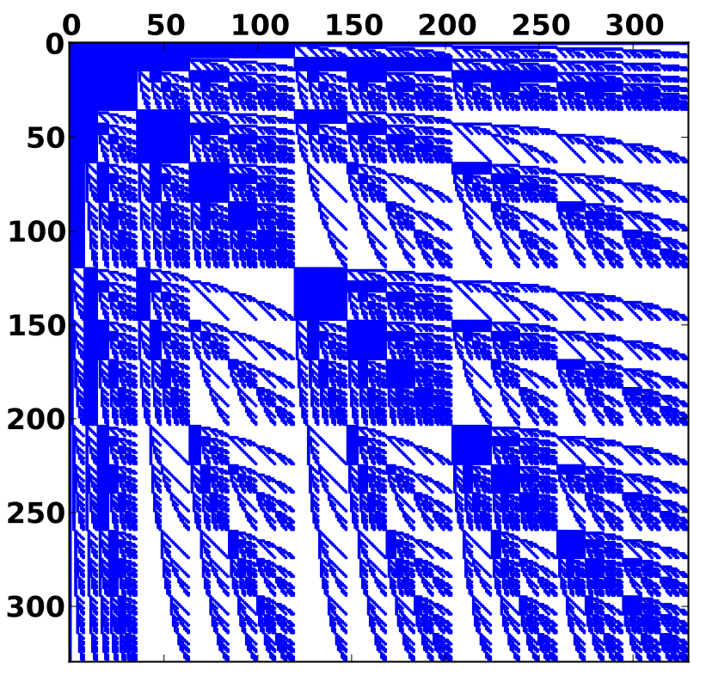
Embedded Stochastic Galerkin UQ Methods
Stochastic Galerkin method (Ghanem and many, many others…):
Method generates new coupled spatial-stochastic nonlinear problem (intrusive)
Advantages:
  Many fewer stochastic degrees-of-freedom for comparable level of accuracy
Challenges:
  Computing SG residual and Jacobian entries in large-scale, production simulation codes
  Solving resulting systems of equations efficiently, particularly for nonlinear problems
Stokhos package provides tools for implementing SG methods for large-scale systems
  Integrates with Kokkos, Tpetra for multicore, MPI parallelism
  Techniques demonstrated in FENL
Stochastic sparsity
Spatial sparsity

Slide 21
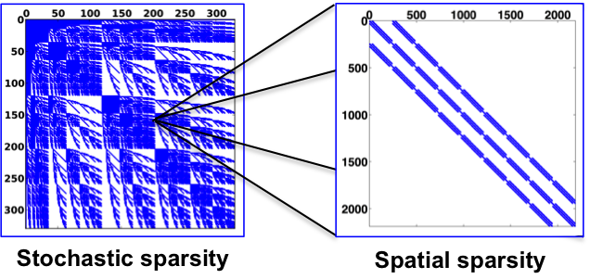
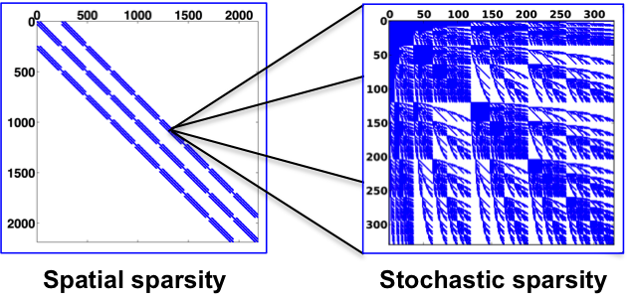
Structure of Galerkin Operator
Operator traditionally organized with outer-stochastic, inner-spatial structure
  Allows reuse of deterministic solver data structures and preconditioners
  Makes sense for sparse stochastic discretizations
For nonlinear problems, makes sense to commute this layout to outer-spatial, inner-stochastic
  Leverage emerging architectures to handle denser stochastic blocks

Slide 22
Commuted SG Matrix Multiply
Two level algorithm
  Outer: sparse (CRS) matrix-vector multiply algorithm
  Inner: sparse stochastic Galerkin product
stochastic basis
stochastic bases sum
stochastic basis
stochastic basis
triple product
FEM basis
FEM bases sum
FEM basis
FEM basis

Slide 23
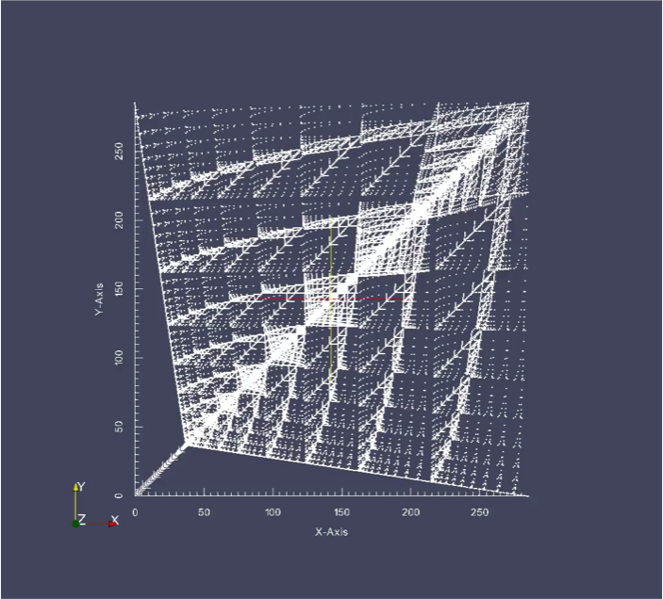
Performance driven by C(i,j,k) tensor
Precompute and store C
Given l,m, load A(:,l,m), y(:,l), x(:,m) into cache
Iterate over non-zero C(i,j,k) entries
Sparse accesses of A, x, but in fast cache
  Very fast for GPU
Lots of reuse of A, x entries
Can load A, x for multiple values of l,m to reduce reads of C

Slide 24
Commuted SG Mat-Vec Throughput
Simple 3D linear FEM matrix (size n = 32x32x32)
N = polynomial order (larger N, denser blocks)
Significant speedup of polynomial approach over original algorithm
  Performance driven by reading Cijk tensor from memory

Slide 25
Commuted SG Mat-Vec Speed-Up
Simple 3D linear FEM matrix (size n = 32x32x32)
N = polynomial order (larger N, denser blocks)
Significant speedup of polynomial approach over original algorithm
  Performance driven by reading Cijk tensor from memory

Slide 26
Concluding Remarks
Propagating uncertainty information at scalar levels exposes new dimension of fine-grained parallelism
  SIMD/SIMT across UQ ensemble
  Reuse data across ensemble
  Packed/coalesced memory accesses
  Simplifies auto-vectorization of complex code
Challenge is incorporating into complex codes
  Leverage template-based generic programming to introduce abstraction at scalar level
  Successful approach in several Sandia application codes
  Working to eliminate manual modifications of kernel launch for CUDA
Propagating UQ info together requires commonality in solution process
  Often need to refine UQ discretization near localized behavior/discontinuities/bifurcations
  How to group samples to exploit commonality when you have it, and separate samples when you don’t?
  Ordering of samples and generating samples with low discrepancy

Slide 27
Auxiliary Slides

Slide 28
Kokkos: A Manycore Device Performance Portability Library for C++ HPC Applications*
Standard C++ library, not a language extension
  Core: multidimensional arrays, parallel execution, atomic operations
  Containers: Thread-scalable implementations of common data structures (vector, map, CRS graph, …)
  LinAlg: Sparse matrix/vector linear algebra
Relies heavily on C++ template meta-programming to introduce abstraction without performance penalty
  Execution spaces (CPU, GPU, …)
  Memory spaces (Host memory, GPU memory, scratch-pad, texture cache, …)
  Layout of multidimensional data in memory
  Scalar type
http://trilinos.sandia.gov
*H.C. Edwards, D. Sunderland, C. Trott (SNL)
Application & Library Domain Layer
Kokkos Sparse Linear Algebra
Kokkos Containers
Kokkos Core
Back-ends: OpenMP, pthreads, Cuda, vendor libraries ...

Slide 29
Tpetra: Foundational Layer / Library for Sparse Linear Algebra Solvers on Next-Generation Architectures*
Tpetra: Sandia’s templated C++ library for distributed memory (MPI) sparse linear algebra
  Builds distributed memory linear algebra on top of Kokkos library
  Distributed memory vectors, multi-vectors, and sparse matrices
  Data distribution maps and communication operations
  Fundamental computations: axpy, dot, norm, matrix-vector multiply, ...
  Templated on “scalar” type: float, double, automatic differentiation, polynomial chaos, ensembles, …
Higher level solver libraries built on Tpetra
  Preconditioned iterative algorithms (Belos)
  Incomplete factorization preconditioners (Ifpack2, ShyLU)
  Multigrid solvers (MueLu)
  All templated on the scalar type
http://trilinos.sandia.gov
*M. Heroux, M. Hoemmen, et al (SNL)

Slide 30
Kokkos Linear Algebra Kernels
Partial specializations for important math kernels
  E.g., CRS matrix-vector product:
KOKKOS_INLINE_FUNCTION
void operator()( const size_type iRow ) const
{
// Compute mat-vec for this row
const size_type iEntryBegin = m_A.graph.row_map[iRow];
const size_type iEntryEnd = m_A.graph.row_map[iRow+1];
scalar_type sum = 0.0;
for (size_type iEntry = iEntryBegin; iEntry < iEntryEnd; ++iEntry) {
size_type iCol = m_A.graph.entries(iEntry);
sum += m_A.values(iEntry) * m_x(iCol);
}
m_y(iRow) = sum;
} // operator()
(also another specialization for CUDA)

Slide 31
Sandy Bridge CPU (4-wide vector)
Grid Size | FEM Size | Ensemble Size | Scalar SpMv GFLOPS | Ensemble SpMv GFLOPS | Ensemble SpMv Speedup
32 | 32768 | 4 | 18.8 | 47.0 | 2.5
32 | 32768 | 8 | 8.0 | 11.9 | 1.5
32 | 32768 | 12 | 7.7 | 11.9 | 1.5
32 | 32768 | 16 | 7.1 | 17.0 | 2.4
32 | 32768 | 20 | 8.9 | 16.7 | 1.9
32 | 32768 | 24 | 8.8 | 16.7 | 1.9
48 | 110592 | 4 | 12.1 | 16.9 | 1.4
48 | 110592 | 8 | 12.2 | 12.4 | 1.0
48 | 110592 | 12 | 9.2 | 11.4 | 1.2
48 | 110592 | 16 | 8.9 | 17.3 | 1.9
48 | 110592 | 20 | 11.0 | 17.5 | 1.6
48 | 110592 | 24 | 10.5 | 17.6 | 1.7
64 | 262144 | 4 | 12.1 | 15.8 | 1.3
64 | 262144 | 8 | 12.1 | 17.0 | 1.4
64 | 262144 | 12 | 11.3 | 16.6 | 1.5
64 | 262144 | 16 | 11.1 | 17.7 | 1.6
64 | 262144 | 20 | 11.4 | 17.7 | 1.6
64 | 262144 | 24 | 11.6 | 17.8 | 1.5
80 | 512000 | 4 | 12.2 | 15.8 | 1.3
80 | 512000 | 8 | 12.2 | 17.0 | 1.4
80 | 512000 | 12 | 12.1 | 16.8 | 1.4
80 | 512000 | 16 | 12.1 | 16.4 | 1.4
80 | 512000 | 20 | 12.0 | 16.0 | 1.3
80 | 512000 | 24 | 12.1 | 16.3 | 1.3
Expected ensemble multiply performance: 12.8 GFLOPS

Slide 32
NVIDIA Kepler K40 (32-wide warp)
Grid Size | FEM Size | Ensemble Size | Scalar SpMv GFLOPS | Ensemble SpMv GFLOPS | Ensemble SpMv Speedup
32 | 32768 | 16 | 16.8 | 37.5 | 2.2
32 | 32768 | 32 | 16.8 | 36.1 | 2.2
32 | 32768 | 48 | 16.8 | 34.9 | 2.1
32 | 32768 | 64 | 16.8 | 33.0 | 2.0
48 | 110592 | 16 | 17.8 | 35.9 | 2.0
48 | 110592 | 32 | 17.8 | 35.9 | 2.0
48 | 110592 | 48 | 17.8 | 35.3 | 2.0
48 | 110592 | 64 | 17.8 | 33.7 | 1.9
64 | 262144 | 16 | 18.1 | 36.1 | 2.0
64 | 262144 | 32 | 18.0 | 36.1 | 2.0
64 | 262144 | 48 | 18.0 | 35.9 | 2.0
64 | 262144 | 64 | 18.0 | 34.3 | 1.9
80 | 512000 | 16 | 17.6 | 36.2 | 2.1
80 | 512000 | 32 | 17.6 | 36.3 | 2.1
80 | 512000 | 48 | 17.6 | 36.2 | 2.1
80 | 512000 | 64 | 17.6 | 34.6 | 2.0
Expected ensemble multiply performance: 36 GFLOPS

Slide 33
Intel Xeon Phi 7120 (8-wide vector)
Grid Size | FEM Size | Ensemble Size | Scalar SpMv GFLOPS | Ensemble SpMv GFLOPS | Ensemble SpMv Speedup
32 | 32768 | 8 | 6.6 | 20.2 | 3.0
32 | 32768 | 16 | 6.6 | 24.2 | 3.7
32 | 32768 | 24 | 6.5 | 23.7 | 3.6
32 | 32768 | 32 | 6.6 | 24.8 | 3.8
32 | 32768 | 40 | 6.5 | 25.6 | 3.9
32 | 32768 | 48 | 6.5 | 27.4 | 4.2
48 | 110592 | 8 | 10.7 | 23.3 | 2.2
48 | 110592 | 16 | 10.8 | 27.5 | 2.6
48 | 110592 | 24 | 10.8 | 26.2 | 2.4
48 | 110592 | 32 | 10.9 | 25.5 | 2.3
48 | 110592 | 40 | 10.9 | 26.7 | 2.5
48 | 110592 | 48 | 10.8 | 27.4 | 2.5
64 | 262144 | 8 | 13.2 | 25.8 | 2.0
64 | 262144 | 16 | 12.9 | 28.2 | 2.2
64 | 262144 | 24 | 12.7 | 24.9 | 2.0
64 | 262144 | 32 | 12.6 | 25.2 | 2.0
64 | 262144 | 40 | 12.8 | 26.2 | 2.1
64 | 262144 | 48 | 12.7 | 26.6 | 2.1
80 | 512000 | 8 | 15.6 | 23.9 | 1.5
80 | 512000 | 16 | 15.3 | 24.7 | 1.6
80 | 512000 | 24 | 15.0 | 24.7 | 1.6
80 | 512000 | 32 | 15.2 | 25.8 | 1.7
80 | 512000 | 40 | 14.6 | 26.6 | 1.8
80 | 512000 | 48 | 15.1 | 27.5 | 1.8
Expected ensemble multiply performance: 44 GFLOPS

Slide 34
SG Linear Systems
Stochastic Galerkin Jacobian:
Stochastic Galerkin Newton linear systems:
Solution methods:
  Form SG matrix directly (expensive)
  “Matrix-free” approach for iterative linear solvers:
    Sparsity determined by triple product tensor
    Only requires operator-apply for each operator PCE coefficient
    Organize algorithm to minimize operator-vector applies

Slide 35
Multicore-CPU: One-level Concurrency
SIMD within a multicore-CPU thread
thread parallel
Each FEM row “owned” by a CPU thread
  2 rows per core on Sandy Bridge
Owning CPU thread computes
  (j,k) loop vectorized (auto-vectorization or intrinsics) for SIMD parallelism
  Vector width = 4 (AVX) on Sandy Bridge

Slide 36
Intel Sandy Bridge CPU
Simple 3D linear FEM matrix (size n = 32x32x32)
N = polynomial order (larger N, denser blocks)
Significant speedup of polynomial approach over original algorithm

Slide 37
Manycore-GPU: Two-level Concurrency
thread-block parallel
thread-block shared memory
serial within a thread
thread-warp parallel
thread parallel
thread-block shared memory
GPU global memory
Multiple levels of concurrency:
  Each FEM row owned by a thread-block
  Each warp within a thread-block owns an “i”
  Warps within a thread perform SG multiply in parallel, executing FEM multiply loop serially
Sparse tensor stored in GPU global memory
  Reduce sparse tensor reads by blocking FEM column loop (“m” loop)
  Heuristic to choose block size based on stochastic discretization size to balance shared memory usage (reduces occupancy) and tensor reads
  Pack (i,j) indices into single 32-bit integer

Slide 38
NVIDIA K40 GPU
Simple 3D linear FEM matrix (size n = 32x32x32)
N = polynomial order (larger N, denser blocks)
Significant speedup of polynomial approach except for larger stochastic discretizations
  Too much shared memory usage per CUDA block reduces occupancy

Slide 39
Manycore-Accelerator: Two-level Concurrency
core parallel
core L1 cache memory
serial within a thread
hyperthread parallel
vector parallel
core L1 cache memory
Accelerator global memory
Map GPU to accelerator architecture:
  GPU thread -> vector lane
  Thread warp -> hyperthread
  Thread block -> core
Use essentially same algorithm as for GPU, except
  Automatic caching of A, x entries instead of shared-memory loads
  Fixed block size for blocking of FEM column loop (“m” loop)
  No packing of (i,j) indices

Slide 40
Intel Xeon Phi 7120P Accelerator
Simple 3D linear FEM matrix (size n = 32x32x32)
N = polynomial order (larger N, denser blocks)
Significant speedup of polynomial approach except for larger stochastic discretizations
  Calculation falls out of L1 cache

